Slide 1
GA Matcher
By Hudson Gribble and Val Ault

Slide 2
Process overview
Copy data into Data Entry sheet - 4 tabs
TA matcher sheet: made by department to help with assigning contracts, has info about TAs
Report from Argos - Past Grades (Registration History, w/ transcript)
Report from Argos - COMP Classes data
Report from Argos - Student schedules
Upload sheet to program, and click on a course
Hover over TA names to see info on whether they would fit that course
Match TAs to Classes, trying to get the hours left for classes and TAs to 0

Slide 3
Excel Sheet - TA Data
Looks like this:
Copy and paste this TA Data into tab “GA”
There are two additional columns, “Should_Teach” and “Should_Not_Teach” - Fill these out, looking through the GA evaluations to see if GA’s are recommended for or against a certain class.
Type these classes like “COMP1900”

Slide 4
Argos reports
Go to http://argos.memphis.edu
It may ask you to download something the first time you go; Do this
Sign in with your U of M credentials
See next page for screenshots

Slide 5
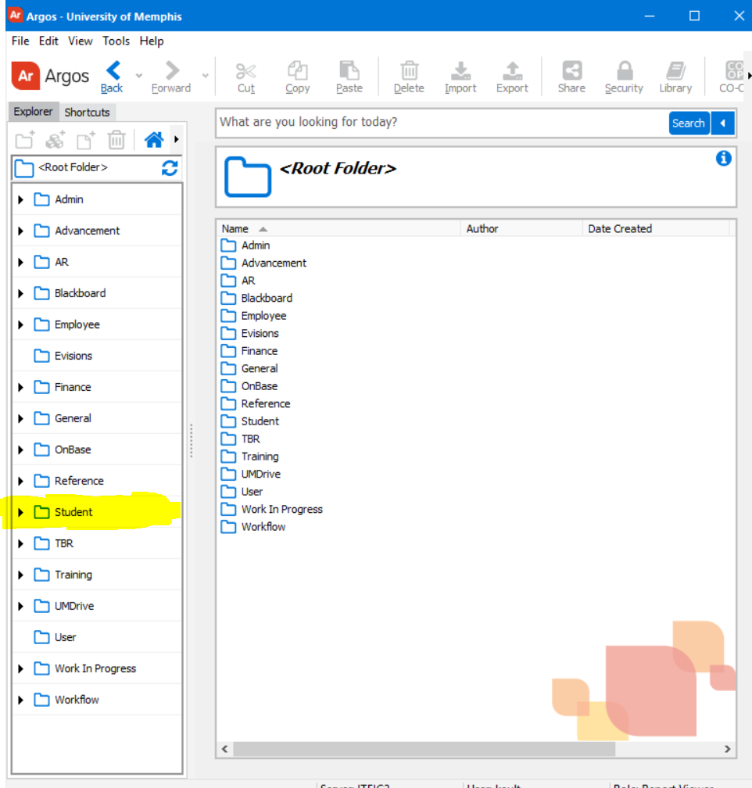
Go to the Student Folder on the left, then the “Miscellaneous” Folder
The reports we’re looking for are:
“SYMIA00030_A - COMP Class SChedules”
“SYMIA00030_B - COMP GR Student Schedules/Registrations”

Slide 6
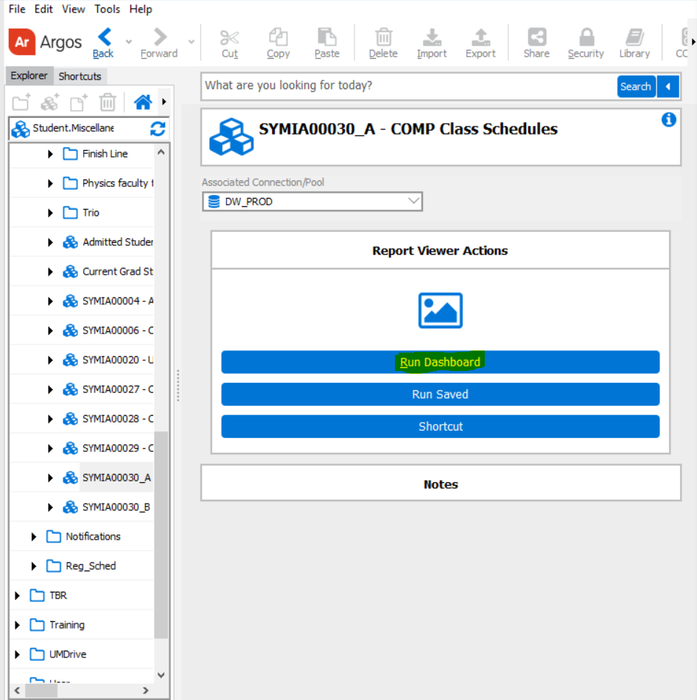
Click “Run Dashboard”

Slide 7
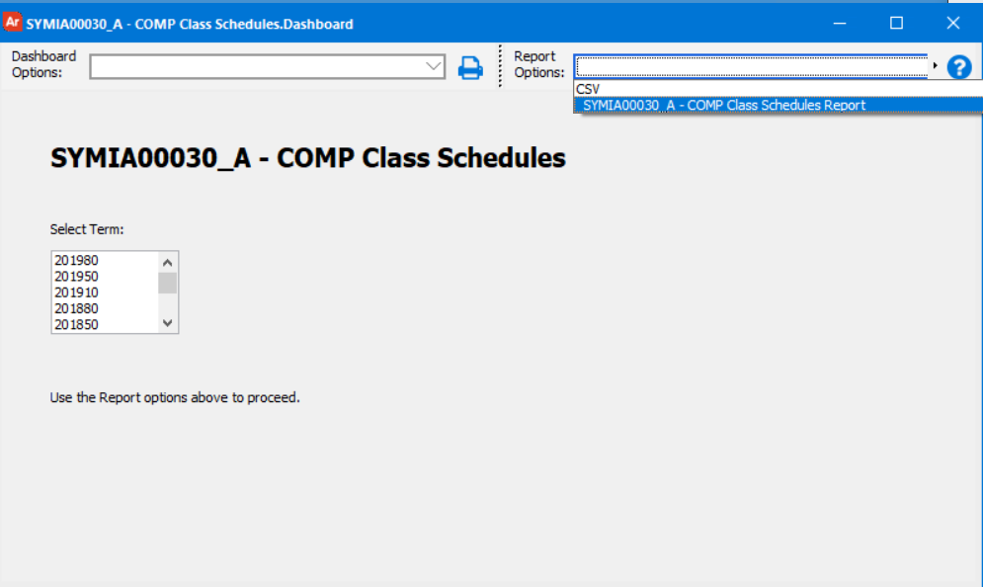
Select a term
For the B report, select “Schedule” or “Registration History, depending on which you need
Select the second option from the “Report Options” Menu (highlighted on right)
Click the floppy disk button next to it to save the file to disk.
Copy this file into the Data Entry Sheet (See next page for tabs)

Slide 8
Tabs
Data Entry
“GA” : TA info Sheet
“Classes” : SYMIA00030_A - COMP Class Schedules
“GA schedules” : SYMIA00030_B - COMP GR Student Schedules/Registration - Select “Schedules”
“Registration History” : SYMIA00030_B - COMP GR Student Schedules/Registration - Select “Registration History”

Slide 9
Using the Program
There are only two pages on this application: The home page, and the file upload page. You should be redirected to the file upload page; If not, click “Upload Excel Sheet” in the top right corner.
Click “Attach File” To select the Data Entry Spreadsheet, and then click “Start Editing” To go back to the Home page

Slide 10
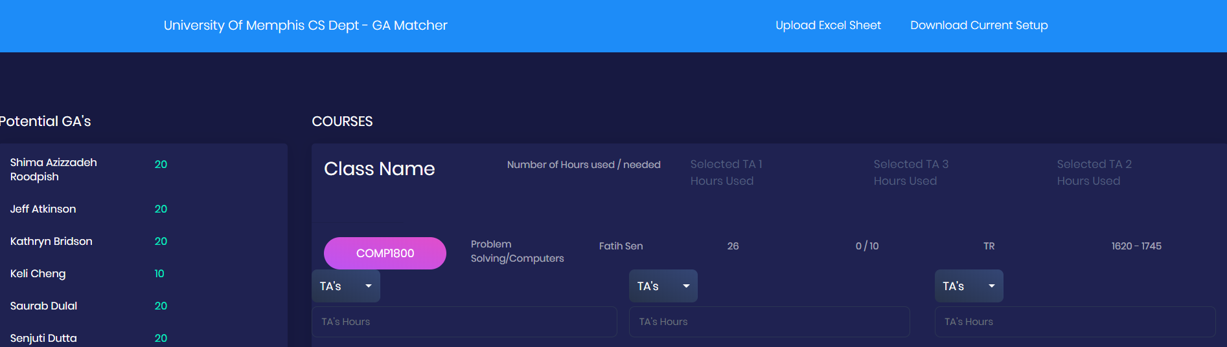
Using the Program
Now you should be on a page that looks like this:

Slide 11
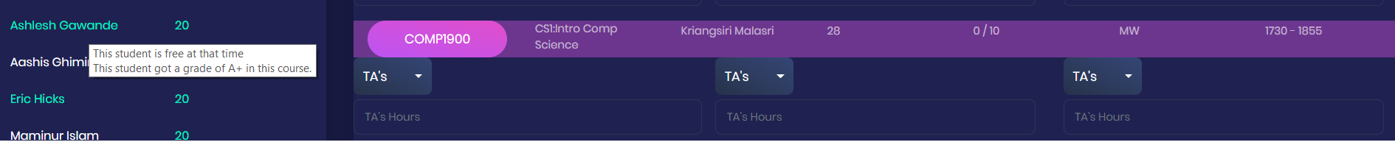
Using the Program
To start, click on one of the class buttons; It will then highlight, that class, and calculate matches for the TA’s. Green highlighted TA’s are good for that class, red are bad, and white are neutral.
Hover over a TA name to see more info on why they are good or bad

Slide 12
Using the Program
Finally, select TA’s using the dropdown boxes right under the class, and type in how many hours that TA should be assigned for that class.
The hours used for that class will update, and they will be subtracted from the available hours of that TA on the left
You may assign more hours than a class or a TA should have, it will just highlight that number in red so you are aware
In picture above, Saurab had 20 hours, and then we inputted 25 hours for COMP 1800 - It subtracted it from his 20 hours, and added it to the classes needed hours (Now it says 25/10 on the right)

Slide 13
Using the Program
When you are happy with the arrangement, click the “Download Current Setup” Button in the top right corner
It will download as a csv file, which you can open in Excel; You can use or edit this file however you want to make some kind of final report.
You’re Done!

Slide 14
Warnings
Does not check if the two classes assigned to a GA conflict with each other
Does not include a GA for the Undergraduate/Graduate/CFIA coordinator, or the LSP Support GA.
IF you want these on the program, you could enter their info into the “Classes” Tab of the Data Entry Spreadsheet.
Enter 40 students for a 20 hour job (Like CFIA Coordinator) Or 20 students for a 10 hour job (Like an undergraduate coordinator)
Make sure to put something in the CRN! Even just 00001 or 00002, but they each must have a unique value under CRN.

